Slide 1
First Panel Meeting
Presenter: Disen Jia
223314816

Slide 2
catalog
01
02
03
My contributions
Evidence
What I have learned

Slide 3
Part one – My contributions
Research report on a PT company – Proton
A Figma design for our website homepage
Immersing myself in helping other team members

Slide 4
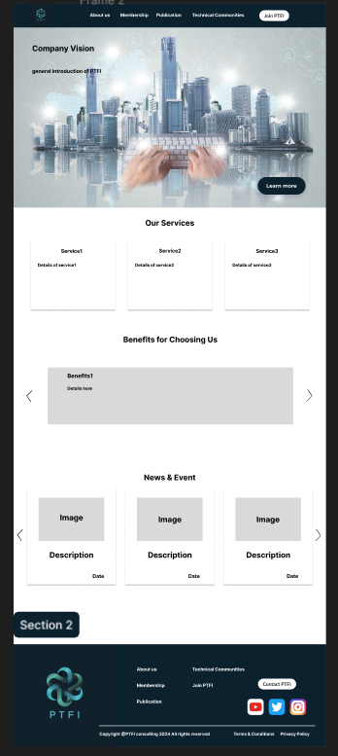
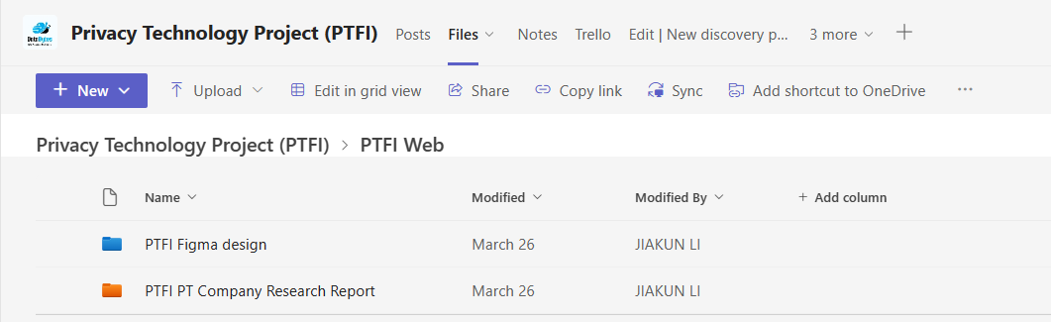
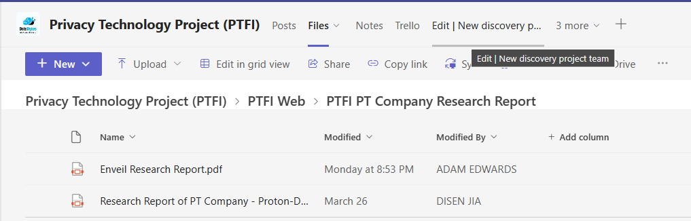
Part two – Evidence
The evidence of Figma design
2. The evidence of the research report

Slide 5
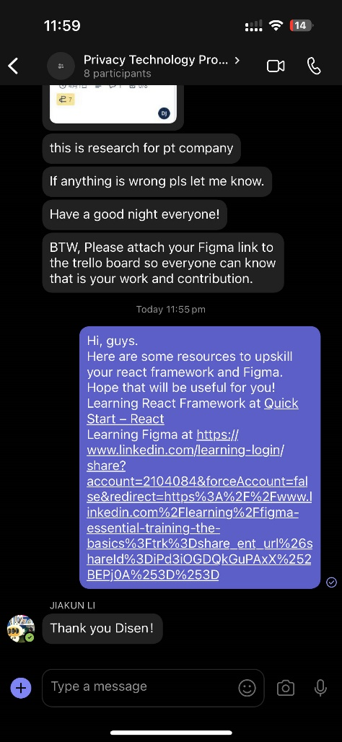
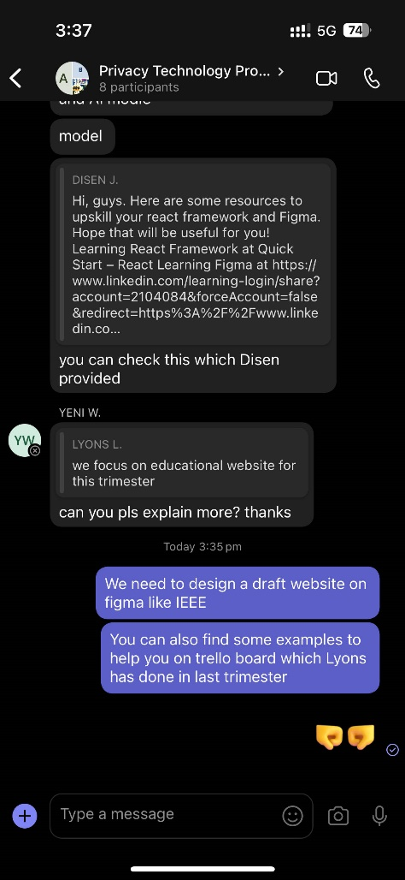
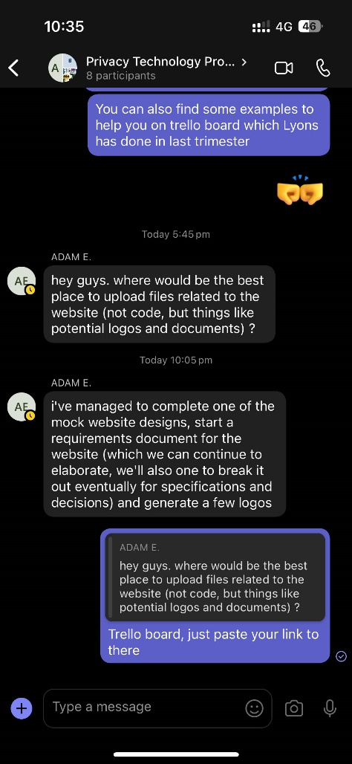
Part two – Evidence
3. The evidence of helping my team members

Slide 6
Part three – What I have learned
How to use Figma to design
React framework

Slide 7
Thanks!
Presenter: Disen Jia
223314816

